Slide 1

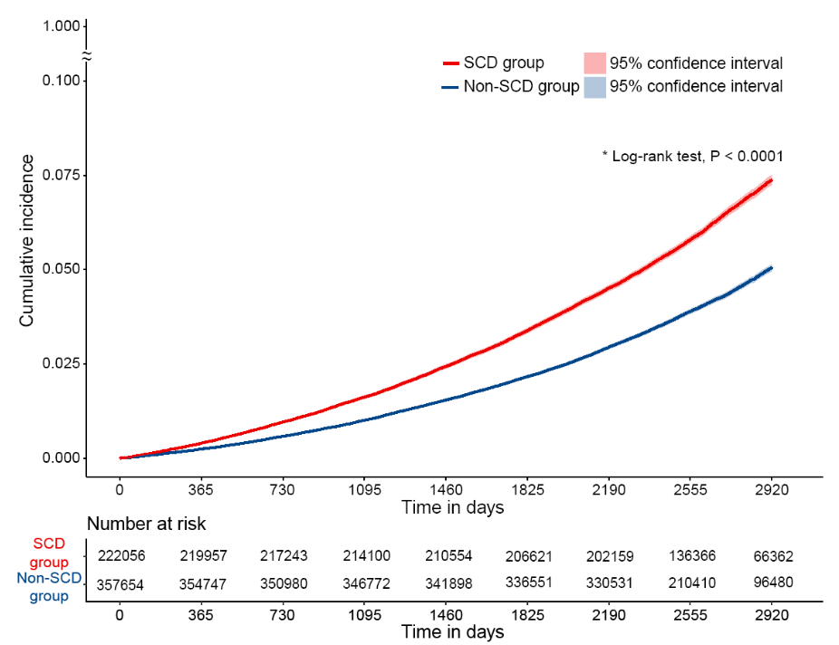

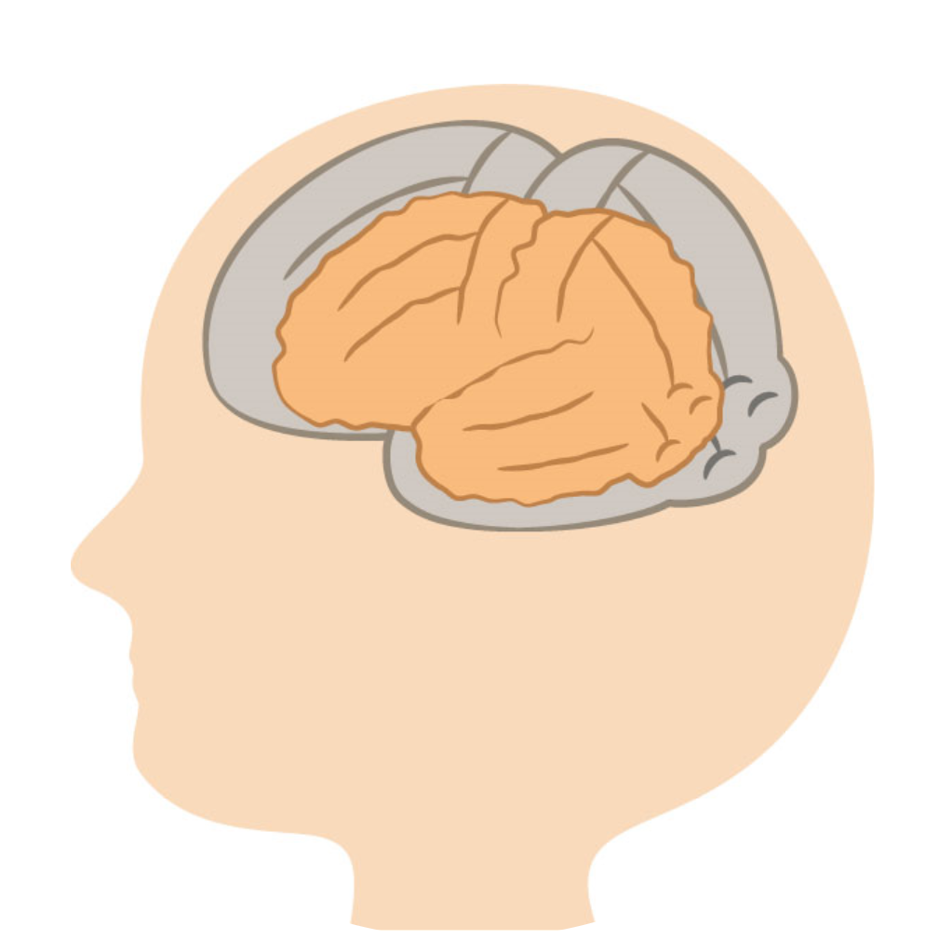
Subjective Cognitive Decline (SCD)
in old adults
Subsequent dementia

